Slide 1
Prepare and Plan
WK DSS 220 Module 3 Lesson 1

Slide 2
Prepare for Data Science
Location
Organization
Collection
Bias
Ethics
Notes:
Now that we have our goal for our data science project, we need to determine several factors about our data before we can move forward.
Location
Often times, the data may be located across multiple locations.
It may be stored on the cloud, or it may reside across multiple databases owned by different people.
Make sure you work with your stakeholder to get access to all of these sources, if this is the case for you.
Organization – Plan out an organization scheme for naming convention, organizing files, and securing data
Collection – we need to see assess what kind of collected data we have and how to process it
Lastly, We’ll cover looking out for bias and performing tasks in an ethical manner

Slide 3
Organization
Directory Structure
Managing Data Sources
Tracking transformations
Tracking assumptions
Code Repositories
Permissions
Notes:
It’s important to take some time up front to create some organization and follow a set of rules for naming and storing your files
Create a directory structure that works for you.
You might want to create a function or functions to easily retrieve the data that you need.
Later on, you might see that you need to transform the data or filter it.
Or you may make some assumptions of the data, such as with handling outliers
It’s very important that you track these in some kind of document along with the reasoning for each one
You want the documentation to be complete so someone else reading it can understand what you did without you having to explain it.
There are several code repositories out there such as GitHub that will help you with version control. This is optional.
But it could be useful if you find that a branch that you took didn’t lead to a useful result and you want to go back to an earlier version of the code.
Finally, if you have multiple people working on this project, you will want to determine what kinds of editing and reading permissions each person will get.

Slide 4
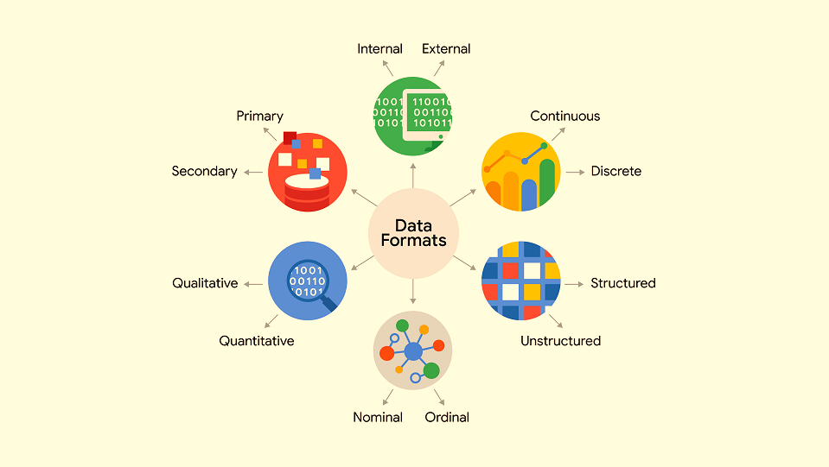
Notes:
Once you’ve got your data, you should start by see what type of data you have.
(Go through the different types)
For some of these, we can find them with simply Python info() and describe() statements. We’ll practice these in our Jupyter lesson later on.

Slide 5
Types of AI Bias
Historical Bias
Representation Bias
Confirmation Bias
Full lecture available here: Link
Notes:
Before you jump into data cleaning, you should take some time to asses any inherent bias in the data or in your reasoning.
These are just a few ways in which your data can be biased. Biased data can lead to faulty conclusions which can be costly.
Historical bias – when model is trained on historically biased data. Such as a resume screener seeing that most CEO’s and executives are men, so it starts to screen out women to hire.
Representation bias – if you have data about different groups, and one is under-represented. The model will work worse for the less represented group. E.g. Facial recognition. Can also apply for maintenance models. If you many cases of a device working properly but only a few of it not working properly, your algorithm might mis-identify a faulty case.
Confirmation bias – if we’re following the scientific method and we have a hypothesis, if the data disproves our hypothesis, that’s an ego-hit. We need to understand in advance that we could be wrong, and if the data shows an alternate conclusion, then you need to go with that.
A full run down of bias and ethics is available at the link, which has a pre-recorded lecture on the Avolve platform.
For all of this following information, there’s a course on the website Kaggle.com on AI ethics, where they also have published sources if you want to delve deeper. I've also cited them in the notes section of these slides.
Source: Suresh, Harini, and John Guttag. "A framework for understanding sources of harm throughout the machine learning life cycle." Equity and access in algorithms, mechanisms, and optimization. 2021. 1-9.

Slide 6
DoD Ethical Principals
Responsible
Equitable
Traceable
Reliable
Governable
Notes:
Responsible. DoD personnel will exercise appropriate levels of judgment and care, while remaining responsible for the development, deployment, and use of AI capabilities.
Equitable. The Department will take deliberate steps to minimize unintended bias in AI capabilities.
Traceable. The Department’s AI capabilities will be developed and deployed such that relevant personnel possess an appropriate understanding of the technology, development processes, and operational methods applicable to AI capabilities, including with transparent and auditable methodologies, data sources, and design procedure and documentation.
Reliable. The Department’s AI capabilities will have explicit, well-defined uses, and the safety, security, and effectiveness of such capabilities will be subject to testing and assurance within those defined uses across their entire life-cycles.
Governable. The Department will design and engineer AI capabilities to fulfill their intended functions while possessing the ability to detect and avoid unintended consequences, and the ability to disengage or deactivate deployed systems that demonstrate unintended behavior.
(Source: https://www.defense.gov/News/Releases/Release/Article/2091996/dod-adopts-ethical-principles-for-artificial-intelligence/)

